Slide 1
About sketchnoting
Matt Penny at Southampton Powershell User group
Notes:
Me
- powershell/sql
- *nix/oracle
- mumps
- vax basic
- books
WTF?
always taken lots of notes
stops my mind wandering
but not much use afterwards
edging towards something more diagramattic
Googled note-taking techniques
Sketchnotes 101
the books
the definition
bit of theory
Ideas not art
Left brain/right brain
Bit of practice
People
Lettering
Logo's
Pictures
Visual vocabulary
My techniques
Not drawing the presenter
Squared paper
Visual vocab
3 columns
Erasable pens
Publish and be damned
Post production vs. Real time
Colour
Advice
try it
Get the book
Search on twitter
Visual vocab thing is good
Do the other stuff – dog barking, biographical details
Webinars especially 24HOP
Publish
Especially for findability
Is it good
I enjoy it
Do I learn better
Don't know
Probably
Stops my mind wandering
Once or twice speaker has pointed out something I've got wrong :)
Find-ability
Most of the speakers have seemed to like them

Slide 2


Me
Sql/powershell
Oracle/unix
Mumps ☺
Sketchnotes
Twitter: @salisbury_matt Blog: mattypenny.net

Slide 3
Agenda
Sketchnoting 101
Why I do it
The way I do it
Some advice
Questions

Slide 4
Sketchnotes 101

Slide 5
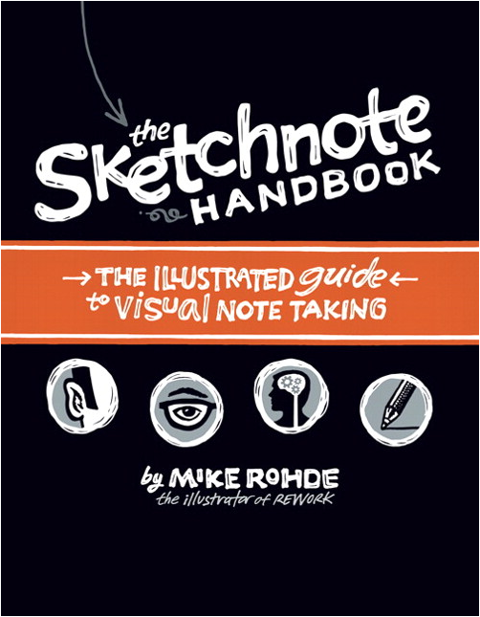
Sketchnotes….'are a thing'
Mike Rohde book in 2012
Mike coined the term
Other people doing similar stuff at the same time
Some overlap with MindMaps, Bullet Journals, Infographics
Community – Sketchnote Army

Slide 6
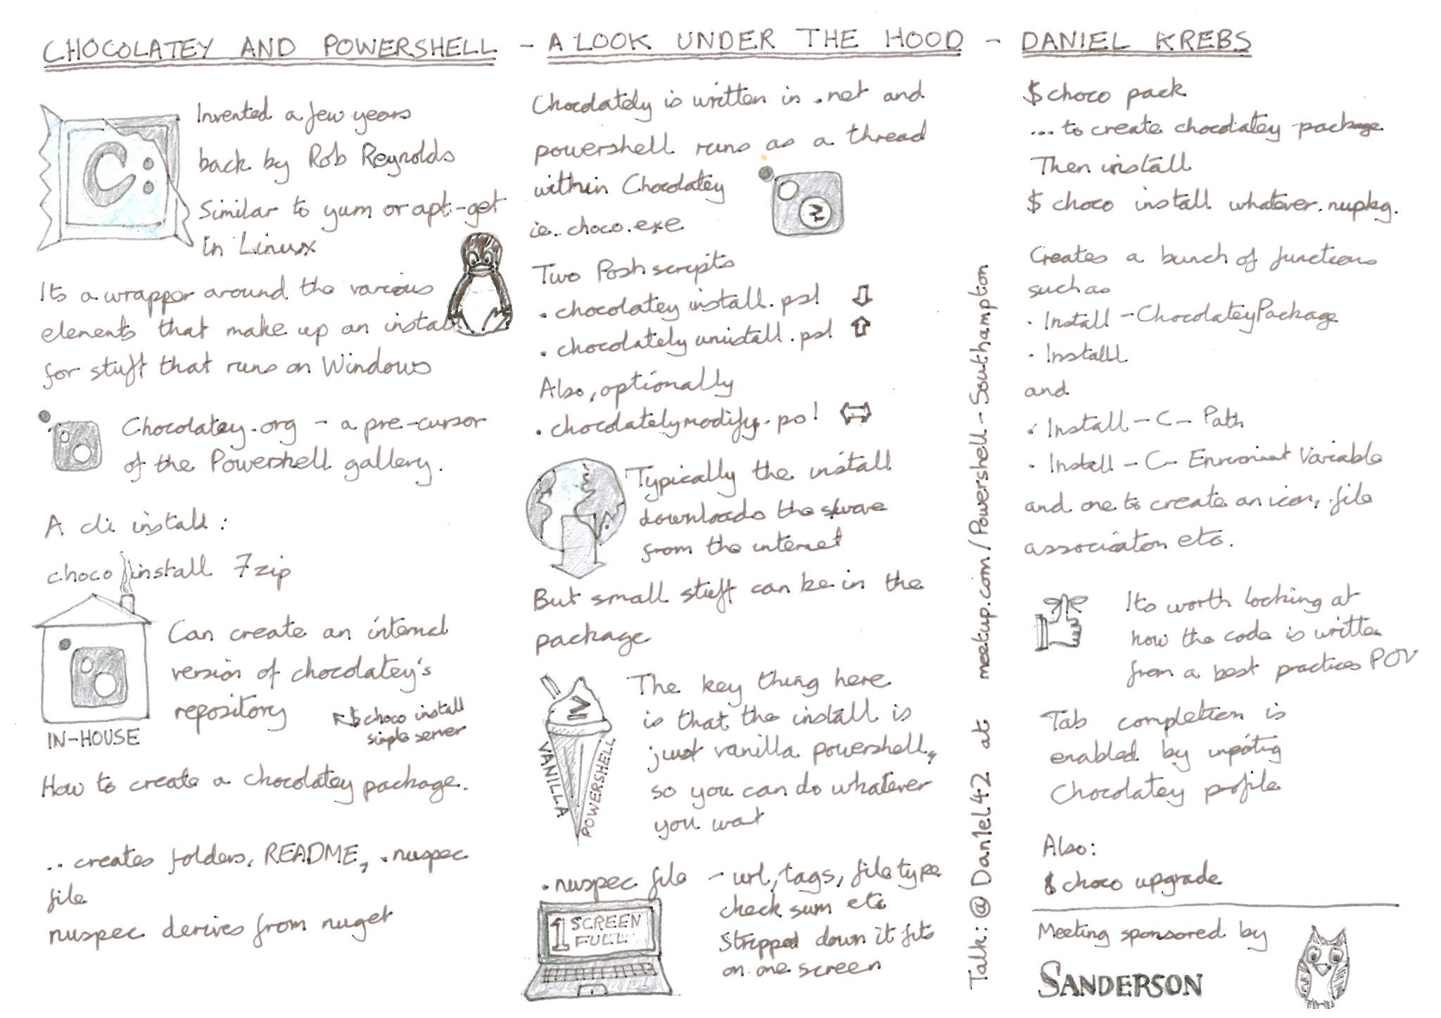
Sketchnotes are....
…."rich visual notes created from a mix of handwriting, drawings, hand-drawn typography, shapes, and visual elements like arrows, boxes, and lines."

Slide 7
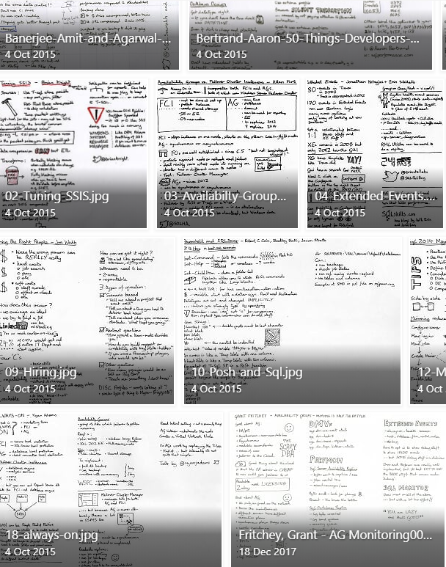
Typically of talks and webinars….
sketchnote of Jonathan Medd on Google Cloud Platform powershell module
sketchnote of Mark Gossa on You Can Do Anything in Powershell….but should you?
sketchnote of Nigel Boulton – Multi-threading in Powershell
sketchnote of Jonathan Medd’s talk on ‘Adventures in DevOps – part 1’
sketchnote of Mark Wragg’s talk on Cross-Platform Development
sketchnote of Jim Moyle on ‘Powershell GUI’
sketchnote of Javier Villegas on ‘Sqlserver 2017 – community-driven enhancements’
sketchnote of Chris Presley, Richard Weiss and Warner Chaves on ‘Running sqlserver on Linux’
sketchnote of Anthony Nocentino on ‘Linux fundamentals for the sql admin’
sketchnote on Stad Sander on ‘Automating Glenn Berry’s DMV scripts’
sketchnote of Ebru Cucen on ‘Powershell on Linux’
sketchnote of Gael Colas on ‘Devops’
sketchnote of Ebru Cucen on ‘The Powershell Module Lifecycle’
sketchnote of Michael Higgins on ‘Kemp products cloud deployment automation’
sketchnote of confluence keyboard shortcuts
sketchnote of Ed Wilson’s talk on ‘Operations Management Suite’
Sketchnote of Ben Hillis, Dustin Kirkland, Russ Alexander, Scott Hanselman discussion about ‘Linux Command Line on Windows’
sketchnote of talk by Rob van der Leek and Željko Obrenović on ‘Building maintainable software for sustainable business growth: 8 best practices’
sketchnote of Javier Villegas talk on ‘Sql Advanced Monitoring’
sketchnote of Mickey Stuewe’s talk on ‘The Silent Killers Lurking in Your Schema’
Sketchnote of talk by Robert Cain, Bradley Ball, Jason Strate on ‘Zero to Hero with PowerShell and SQL Server’
Sketchnote of Ryan Adams talk on ‘SQL Server AlwaysOn Quickstart’
Sketchnote from Grant Fritchey’s talk on SQL 2016 features ‘A partly cloudy future’
but other uses include…..

Slide 8
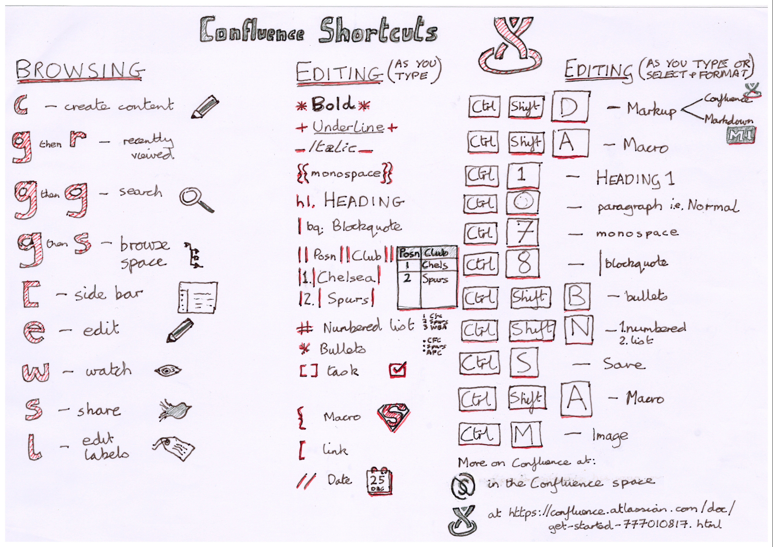

Slide 9
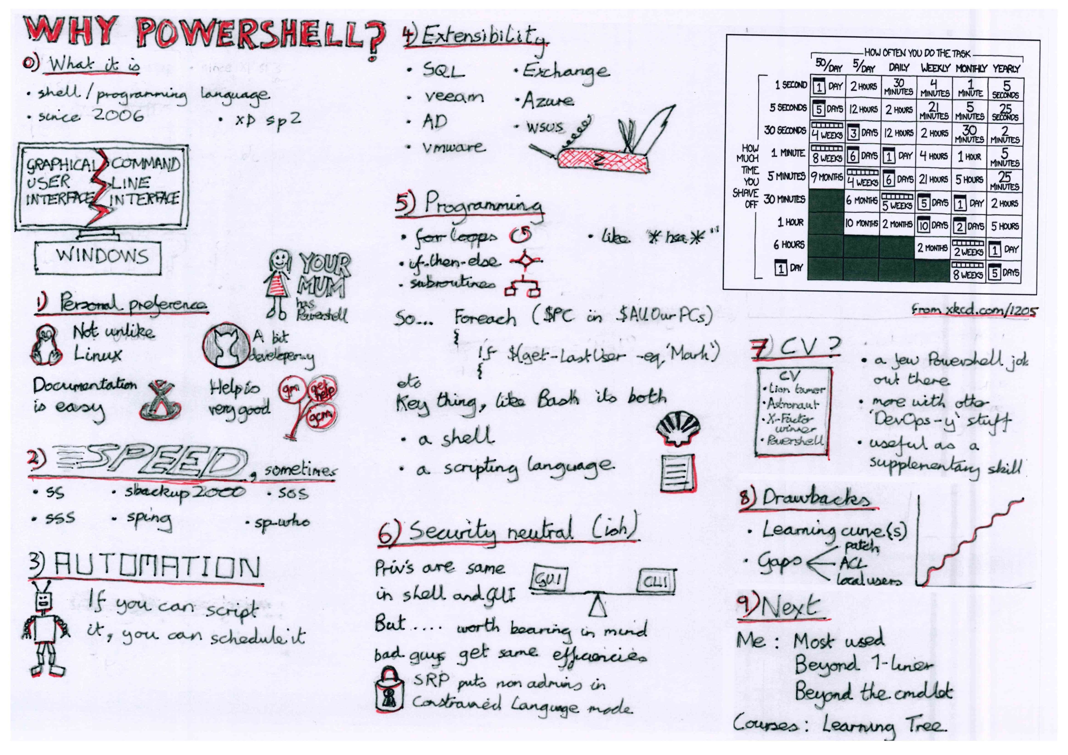

Slide 10

This sketchnote is by Mike Rohde from 'The Sketchnote Workbook. Mike's website is www.rohdesign.com

Slide 11
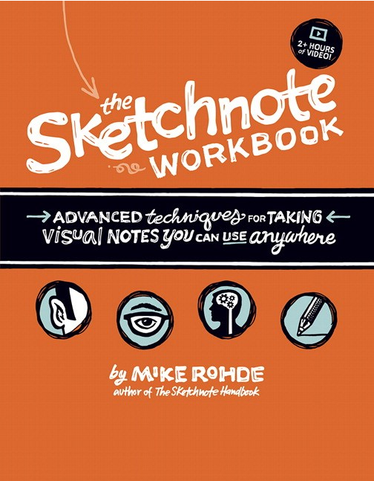
The books
Mike Rohde's books
Handbook first
Video editions too
On SafariOnline
rohdesign.com

Slide 12
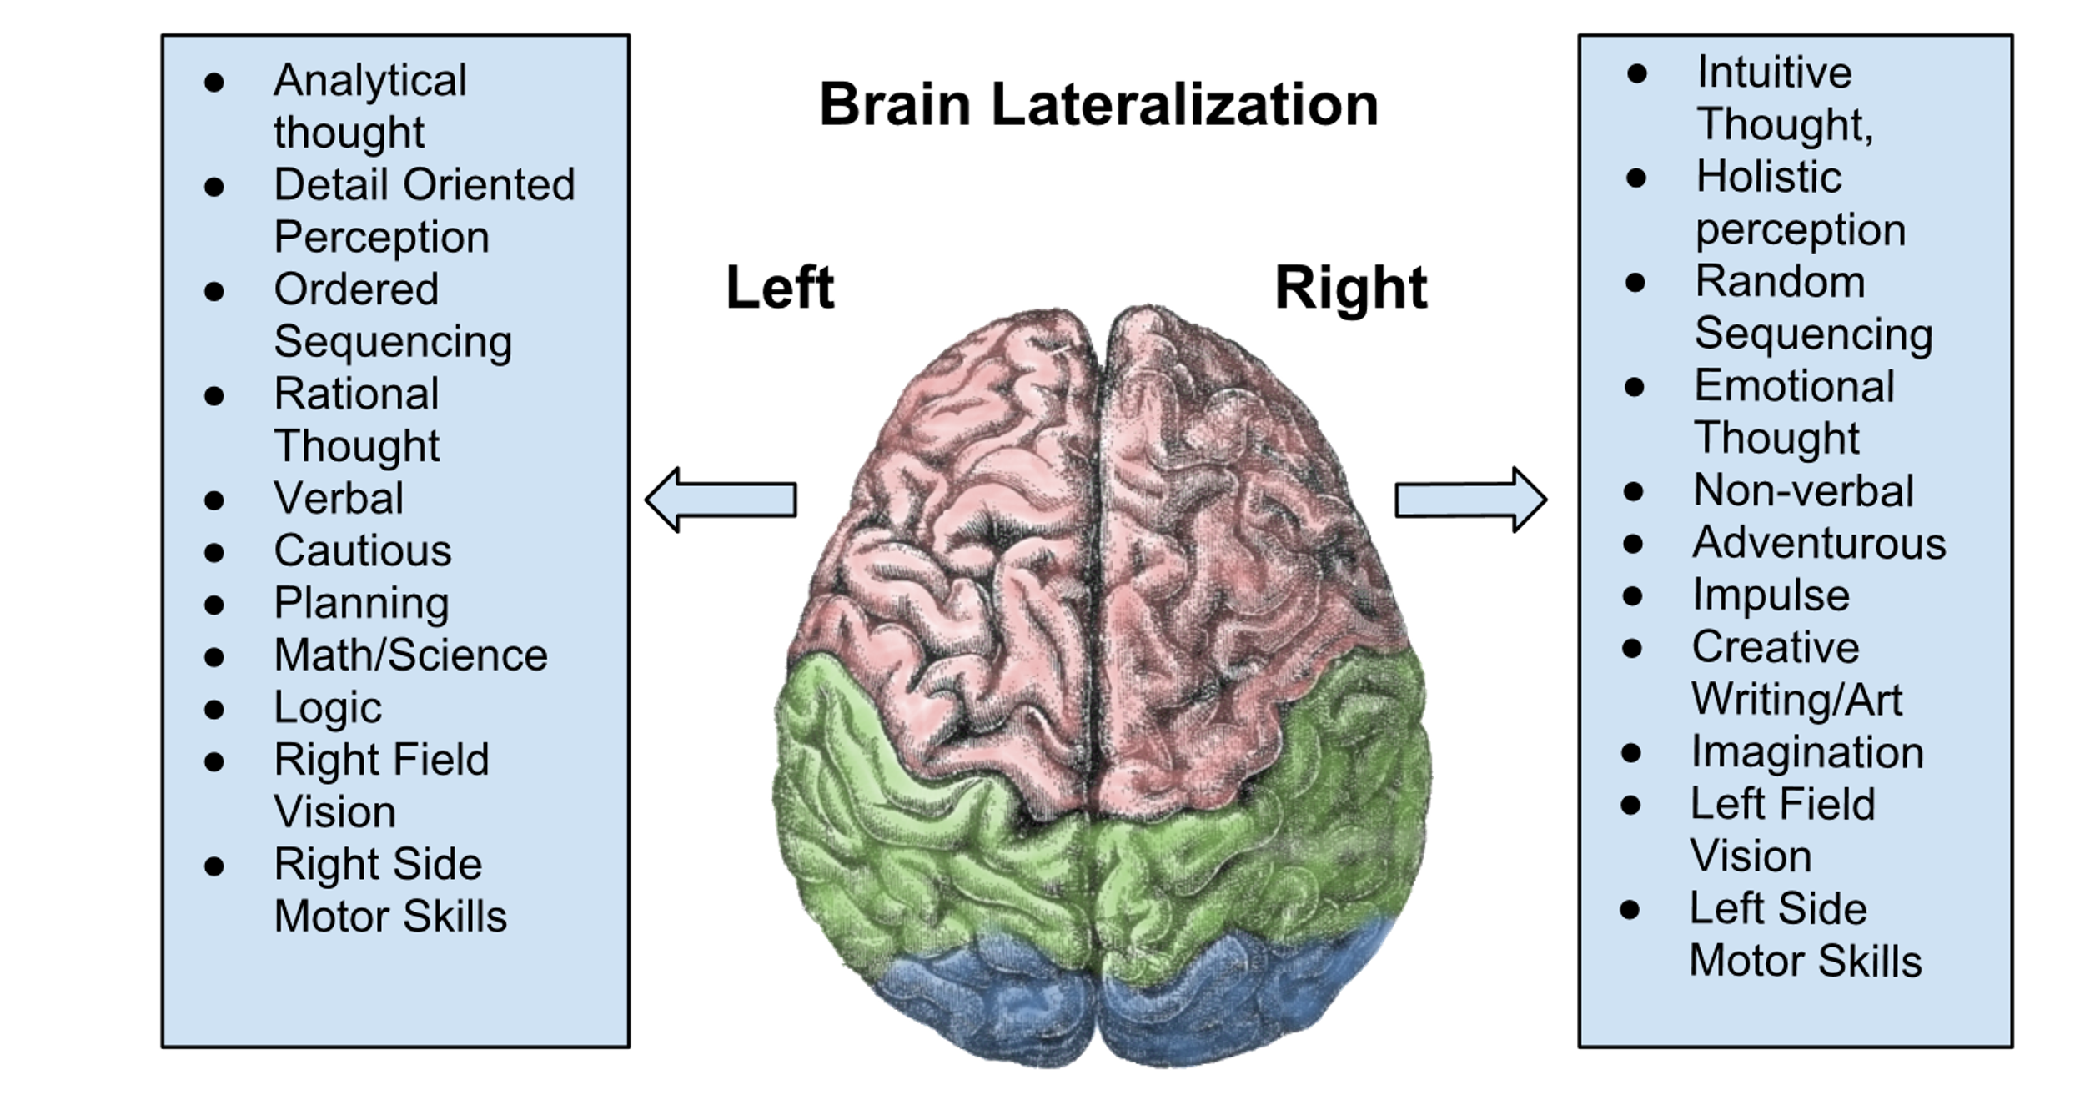
A bit of theory – 2 sides of the brain
Image: Chickensaresocute [CC BY-SA 3.0 (https://creativecommons.org/licenses/by-sa/3.0)]

Slide 13
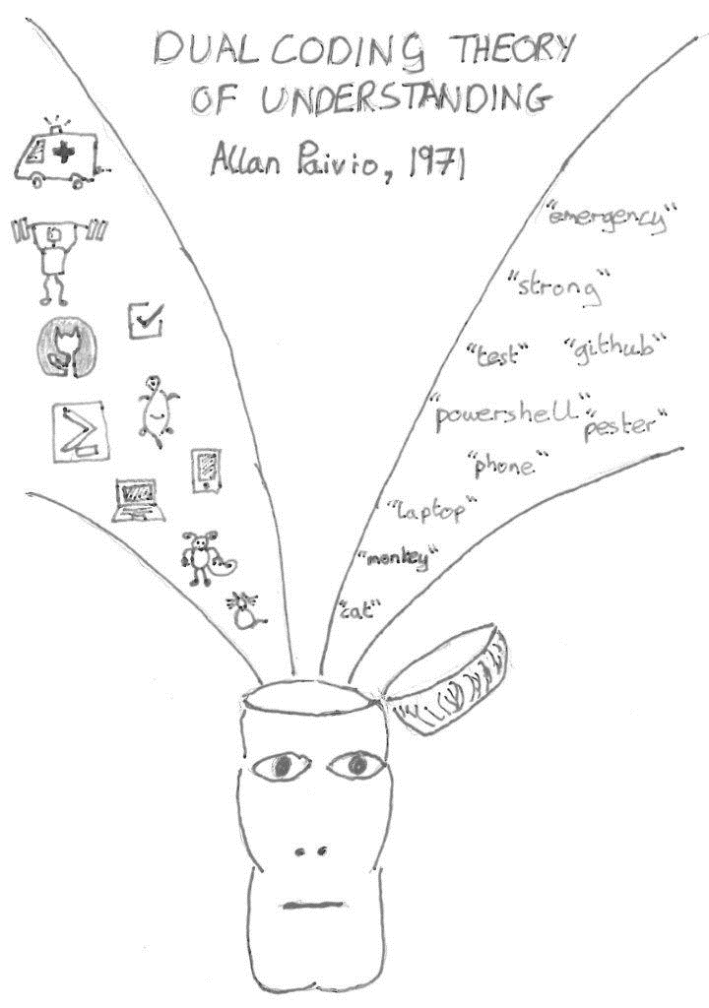
A bit of theory – dual coding
Allan Paivio, psychologist and ’Mr Canada’
verbal codes
visual codes
Wikipedia: “The ability to code a stimulus two different ways increases the chance of remembering that item”

Slide 14
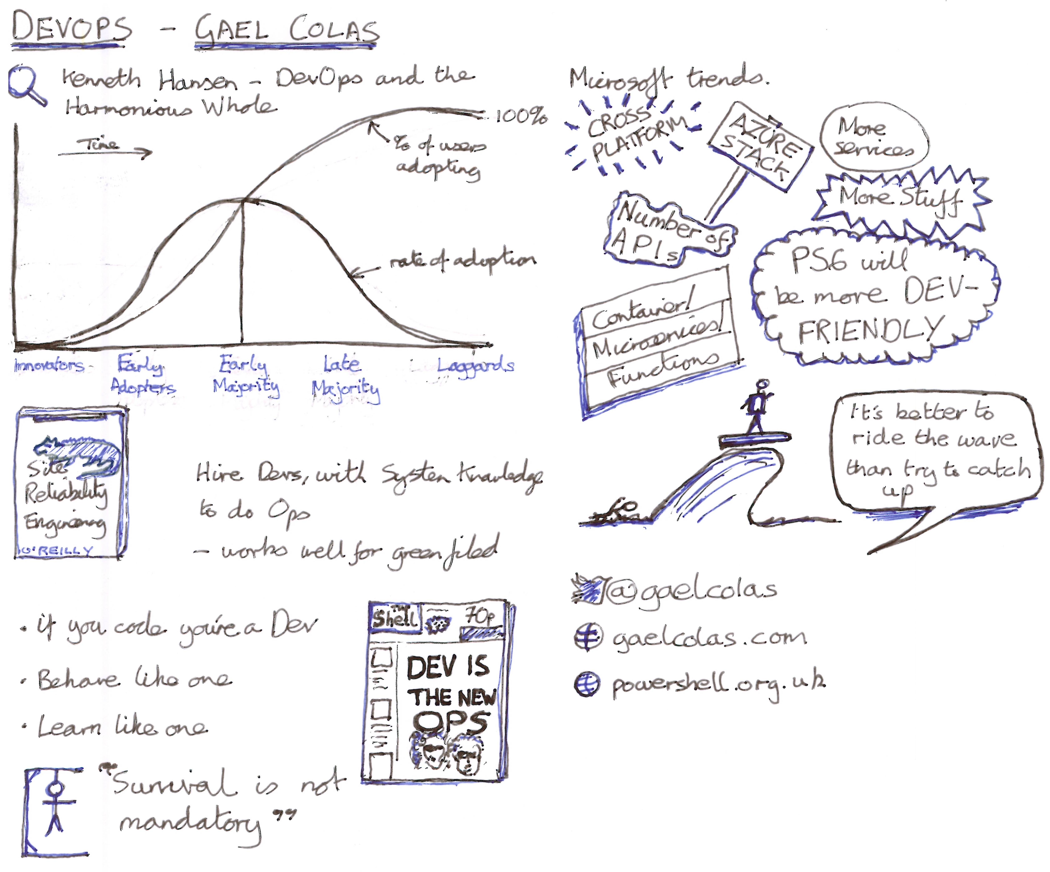
Combination of visual and verbal
Natural-ish handwriting
Emphasis - caps, colours, block text, underline
Dividers

Slide 15
Why I sketchnote

Slide 16

Why?
Do I learn better?
I don't know
Probably

Slide 17
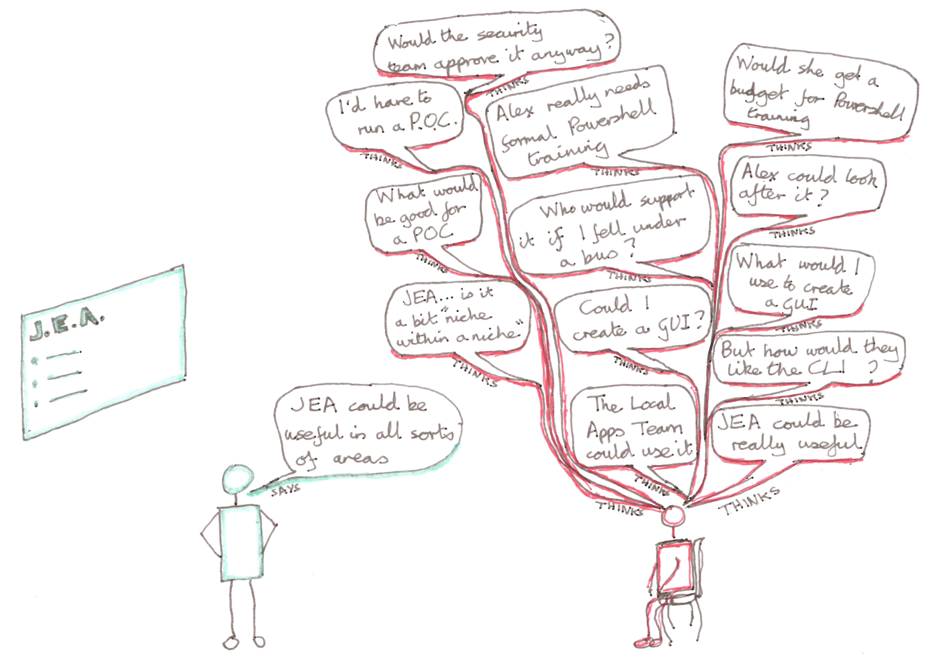
Why? - Staying in the room

Slide 18
Why? - also
Once or twice speaker has pointed out something I've got wrong :)
Find-ability
Elements of the process afterwards constitute a review of the material
I enjoy it
Speakers generally seem to like it

Slide 19
How I sketchnote

Slide 20
A bit of practice – people, and pictures
DEMO

Slide 21


Slide 22
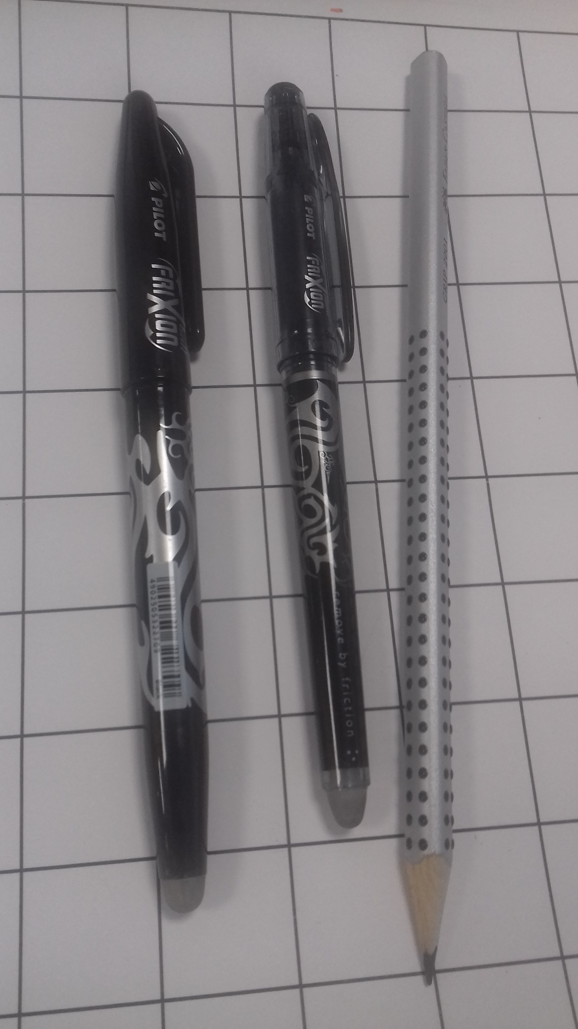
My way – stationery etc
A4 paper, stolen from printer
Eraseable ink!
2B pencil
Squared paper beneath
Scanner
Sometimes move stuff around/tidy bits up in MS Paint
…but also see….

Slide 23

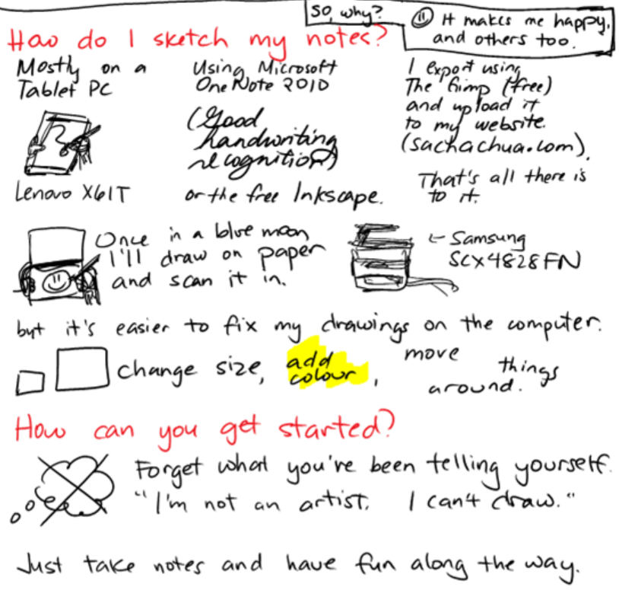
Sacha Chua
Sketchnoting on a tablet
https://sachachua.com/blog/2012/09/paper-tablet-and-tablet-pc-comparing-tools-for-sketchnoting/
Podcast with Mike Rohde
https://sachachua.com/blog/2013/02/transcript-of-my-chat-with-mike-rohde-the-sketchnote-podcast-on-digital-sketchnoting/

Slide 24
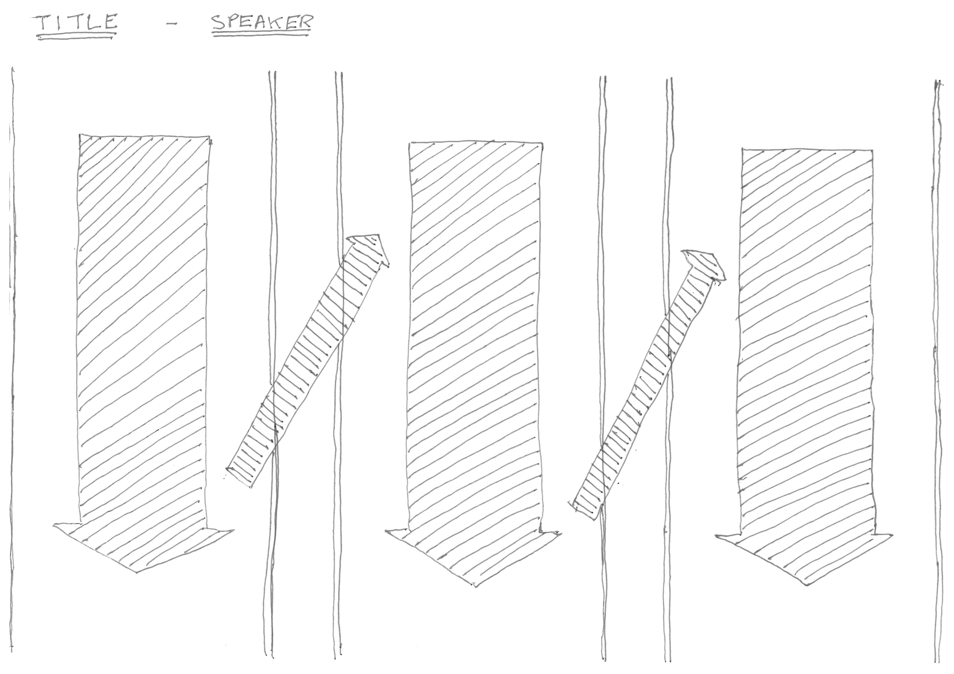

My way – the notes
Three columns per page
More pages if need be
I don’t draw the speaker…..except…

Slide 25
Touching it up vs. real time
Trade-offs
Time
Immediacy
Not getting it done
Better notes
Element of review
Colour

Slide 26
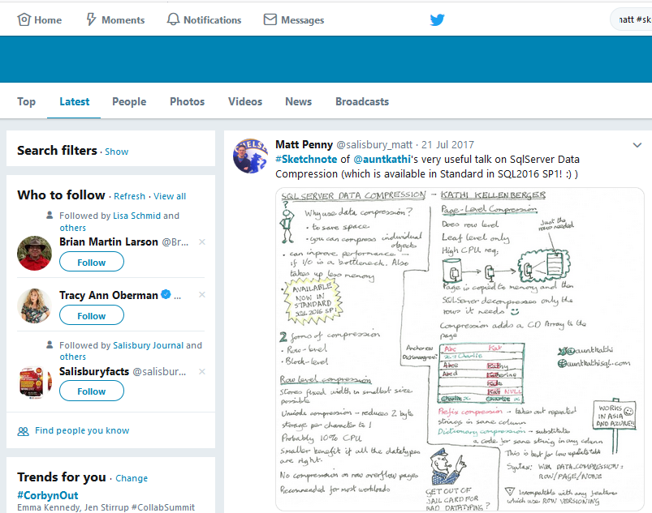
Publish
(nearly) always publish
keeps it honest
find-ability
usefulness for others?
presenters like it…I think
corrections
copyright?

Slide 27
Advice

Slide 28
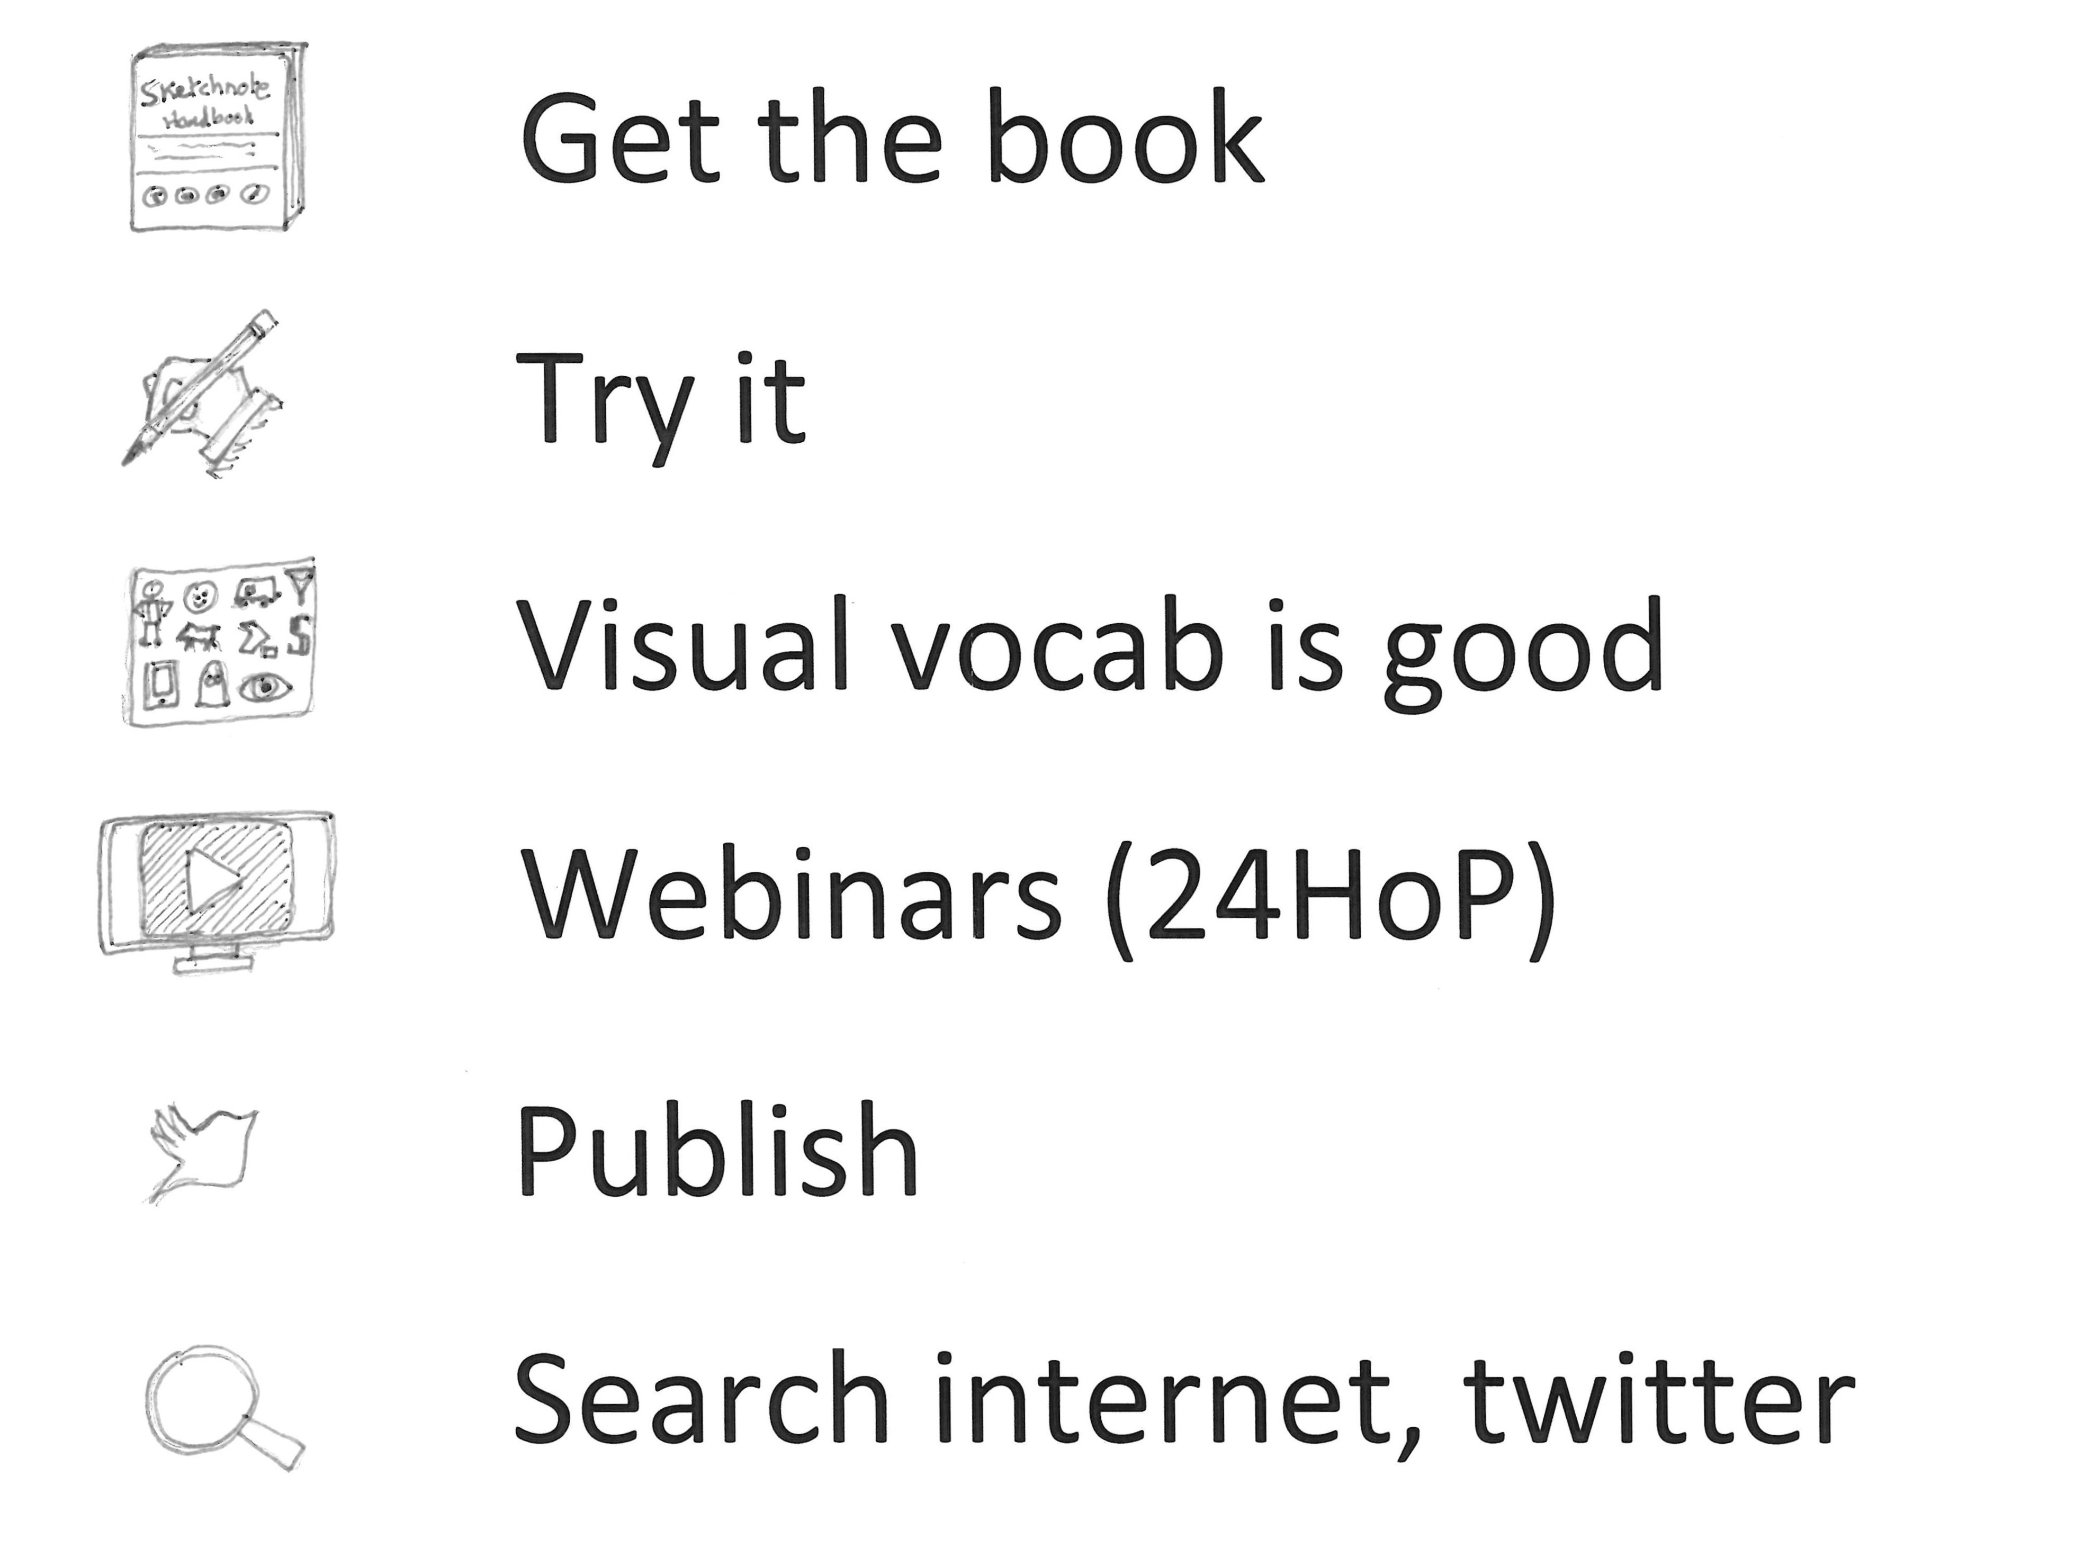
Advice…

Slide 29
Even more advice…
Sketchnoting might or might not be for everyone
Worth thinking about how you learn best

Slide 30
References
The PowerShell Best Practices and Style Guide https://poshcode.gitbooks.io/powershell-practice-and-style/
Unix Person's Guide to Powershell: https://leanpub.com/aunixpersonsguidetopowershell/read
Sketchnote Army: https://sketchnotearmy.com/
The Sketchnote Handbook: https://www.hive.co.uk/Product/Mike-Rohde/The-Sketchnote-Handbook--the-illustrated-guide-to-visual-note-taking/14082734
The Sketchnote Workbook: https://www.hive.co.uk/Product/Mike-Rohde/The-Sketchnote-Workbook--Advanced-techniques-for-taking-v/15952552
Sketchnoting with a tablet
https://www.youtube.com/watch?v=5LrEfnFzYyY&list=PLCdugvAzY7lZMqV2VguMVPWEzW1aftQ1a&index=4
http://sachachua.com/blog/2014/02/freepay-want-resources-sketchnoting-autodesk-sketchbook-pro/
https://sachachua.com/blog/2012/09/paper-tablet-and-tablet-pc-comparing-tools-for-sketchnoting/
Dual-coding theory: https://en.wikipedia.org/wiki/Dual-coding_theory

Slide 31
Sketchnotes on twitter
https://twitter.com/ImpactWales
https://twitter.com/sylviaduckworth
https://twitter.com/SketchnoteArmy
https://twitter.com/evalottchen
https://twitter.com/rohdesign
https://twitter.com/xLontrax
https://twitter.com/LuiseFreese
https://twitter.com/sachac
https://twitter.com/search?f=tweets&q=%40salisbury_matt%20sketchnote&src=typd

Slide 32

Questions? Thoughts?

